Slide 1

Applied Data Science Capstone Project
Segmenting and clustering neighbourhoods of Fredericton City

Slide 2
Project Scope
What neighbourhoods have the highest crime?
Is population density correlated to crime level?
Using Foursquare data, what venues are most common in different locations within the city?
Does the Knowledge Park really need a coffee shop?

Slide 3
Datasets of the project
1. Open data
2. Foursquare data for venues
3. Fredericton Crime by Neighbourhood
4. Fredericton locations of interest

Slide 4
Methodology
Loading each data set
Determine crime frequency by neighbourhood
Study the crime types based on neighbourhood
Identify correlation between crimes and population density
Perform k-means statisical analysis on venues by locations of interest based on findings from crimes and neighbourhood
Determine which venues are most common statistically in the region of greatest crime count then in all other locations of interest.
Determine if an area, such as the "Knowledge Park" needs a coffee shop.

Slide 5
Results
Crime freqency by neighbourhood
Total crimes in the city
Crime type count by neighbourhood.
Theft from motor vehicles is most prevalent.
Using k-menas, we were able to determine the top 10 most common venues within a 1 km radius of the centroid of the highest crime neighbourhood.
The most common venues in the highest crime neighbourhood are *coffee shops followed by Pubs and Bars *

Slide 6
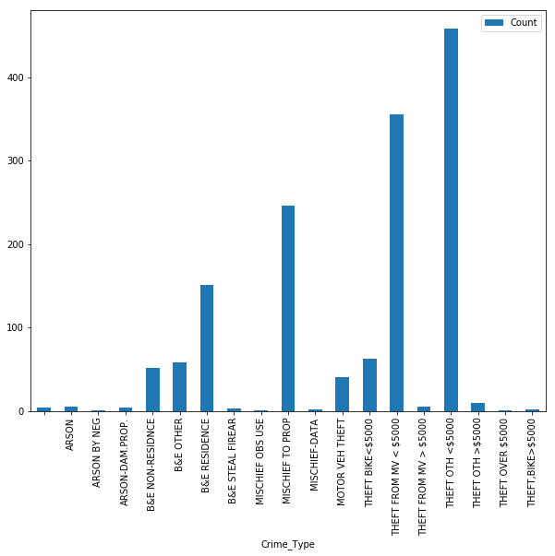
Plot

Slide 7
Conclusion
1. All in all, the City of Fredericton Open Data is interesting, it misses the details required for true valued quantitative analysis and predictive analytics which would be most valued by investors and developers to make appropriate investments and to minimize risk.
2. However, the inference from open dataset and foursquare API is a good starting point to know more the various neighborhoods in the city and understand the crime incidents.

Slide 8

THANKS

